Slide 1
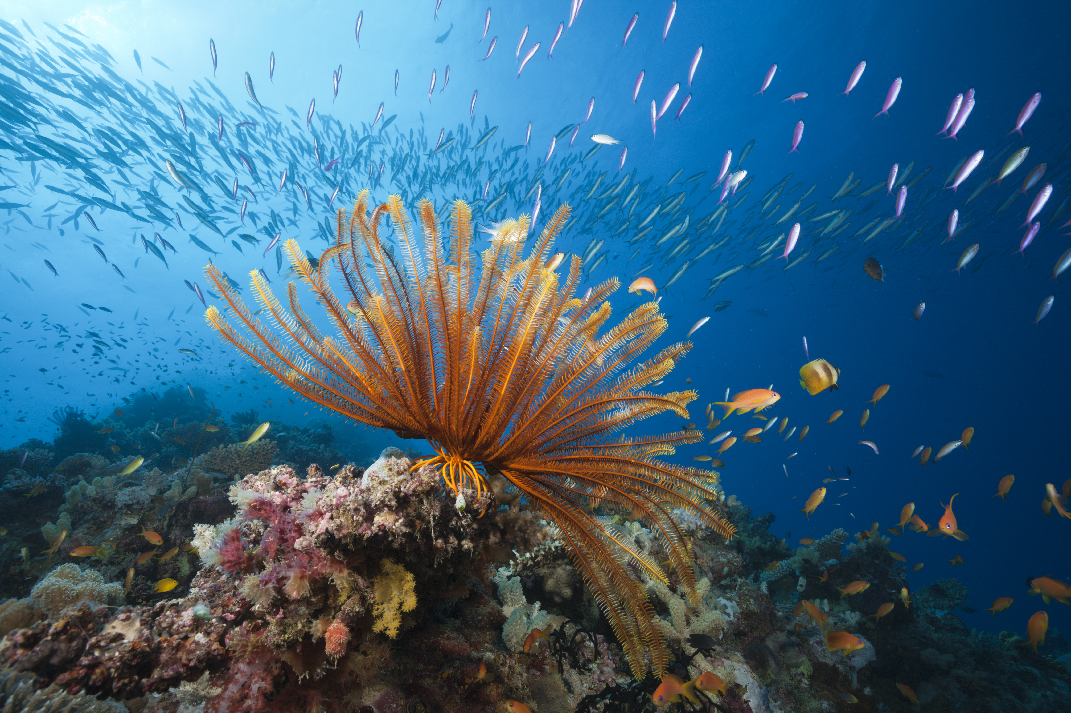
ANALYSIS OF SOCIAL REACTION
TO CORAL REEF DAMAGE
Matthew Berning, Paula Gallardo,
Macda Gossa, Haile Kebede, David Makana

Slide 2

Summary
Motivation
Research Questions
Data Sources
Findings Summary
Data cleaning & Exploration
Data Analysis
Discussion of Findings
Post-Mortem Discussion
Questions & Answers

Slide 3
Motivation
Coral reefs are extremely complex, economically and ecologically valuable ecosystems
Recently, these ecosystems have come under threat due to, pollution, climate change and ocean acidification
These stressors have resulted in bleaching events and coral die-offs that in most cases have resulted in substantial losses of coral reefs around the world
We are interested in determining how people around the world are responding to these events

Slide 4
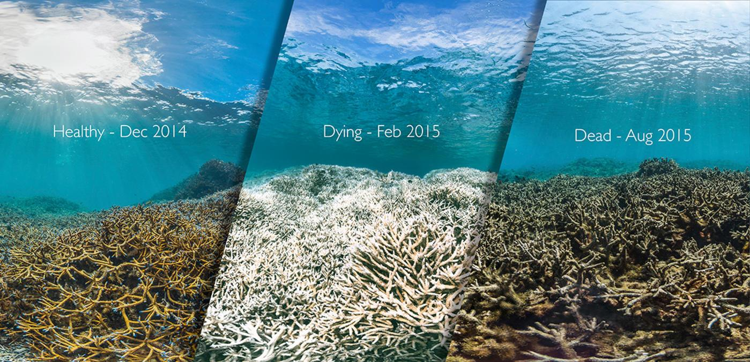
This image shows the same reef in American Samoa before, during, and after a coral bleaching event.

Slide 5
Research Questions
Hypothesis:
When coral reefs are damaged they will elicit strong/measurable reactions in people -because they are charismatic and beautiful ecosystems.
Initial research questions:
How has public response to coral reef damage changed over time?
Where is public response the strongest, when?
Has reef damage and public response affected policy?
What is the correlation of ocean warming and coral damage?
How do coral damages events correlate to public response by tweets and news portals?
What does the map of public response look like in relation to where damage occurs globally?

Slide 6
Data Sources
Reefbase: Global Database on Coral Reef
Project focused mainly on Coral Bleaching Dataset which provides observation details of coral bleaching
Dataset main sources of information:
National Oceanographic and Atmospheric Administration (NOAA)
Australian Institute of Marine Science (AIMS)
Great Barrier Reef Marine Park Authority (GBRMPA)
ReefBase online Bleaching report
Google Trends data
Internal Google Metrics determined by search frequency of keywords and weighted by total searches for time-bins
Rankings for search terms from 0-100 (arbitrary scale)
NYT API
Article Search API to access article counts by keyword over timeframe

Slide 7
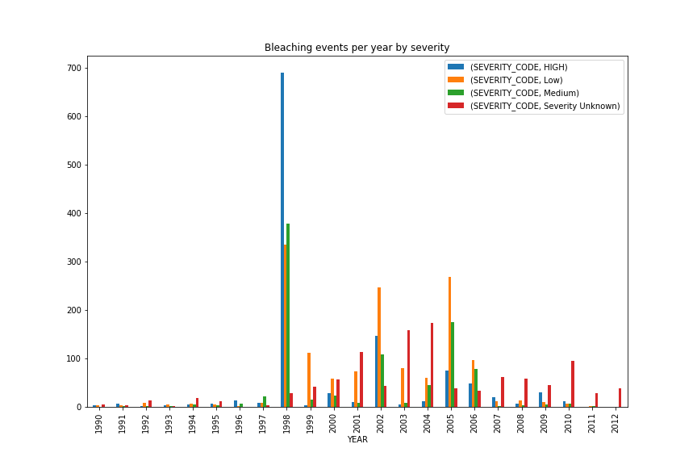
Results, Graphs!

Slide 8
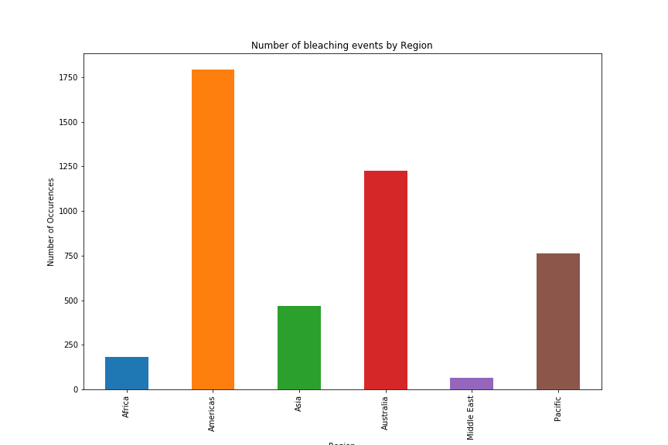
Results, Graphs!

Slide 9
Results, Graphs!

Slide 10
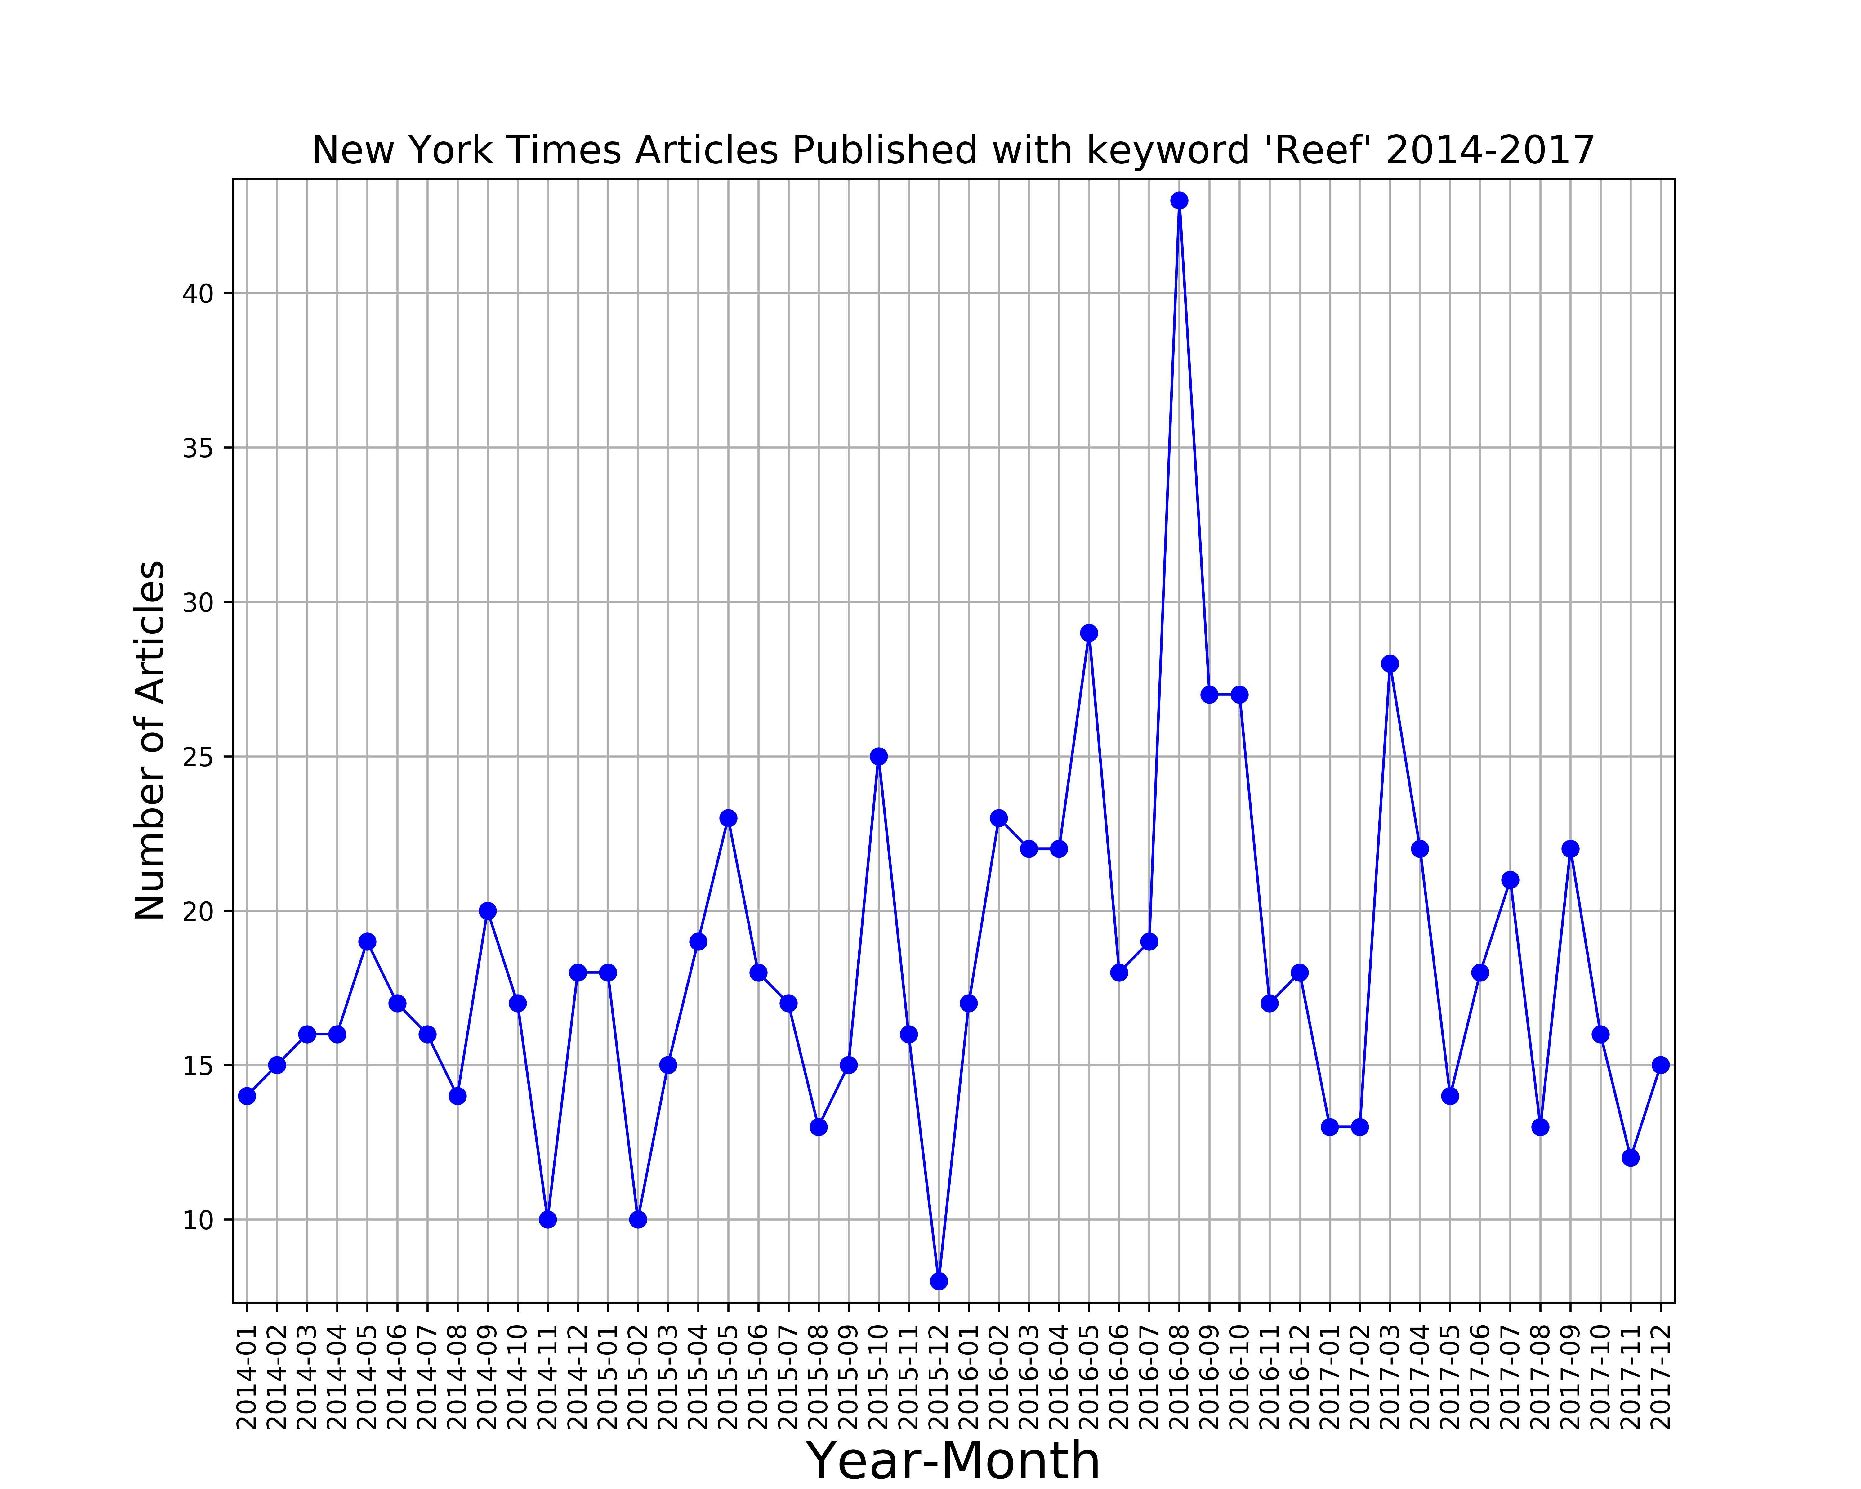
Results, Graphs!

Slide 11
Results, Graphs!
Interesting note!
The articles published by the NYT peak in August of 2016
The Search Interest Trend Peaks in October of 2016
The Global Bleaching Event began in 2014 and reached its maximum in the early part of 2016 - when the great barrier reef was most affected, coinciding with the 2015-16 El Niño

Slide 12
Results, Graphs!
Approx. Bleaching
Event
Maximum
Interesting note!
The articles published by the NYT peak in August of 2016
The Search Interest Trend Peaks in October of 2016
The Global Bleaching Event began in 2014 and reached its maximum in the early part of 2016 - when the great barrier reef was most affected, coinciding with the 2015-16 El Niño
Approx. Bleaching
Event
Maximum

Slide 13
Summary of Findings
Mass global bleaching events have occurred in 1998, 2002, 2005-2006 and most recently 2016 caused by unusually warm sea surface temperatures during the summer season
Observed spike in interest in Google Trend Data and New York Times Article publishing count at the same time as the global bleaching event in 2016 (i.e. hypothesis partially confirmed)
Additional interesting finding: tourism seasonality is a direct influence on the frequency of the search queries related to coral reefs

Slide 14
Data Cleanup & Exploration
Exploration and cleanup process of Reef-Base Data
Preview of the DataFrame
Identify incomplete information and delete columns
Fill nan with 0
Check the column datatype in order to do plotting
Google Trend Process
Generate keyword list (>100), using tag-cloud/native google processes
Import keywords and generate csv files
Combine massive csv into large data frame
Assign average search interest to groups within dataframes
Plot
NYT API Process
Establish article count using time frame, append article to list, use len to get number of articles
Combine count into csv then data frame
Plot

Slide 15
Data Cleanup & Exploration
Unanticipated insights while exploring the data:
There is a greater interest in Great Reef Barrier than other reefs
It is the most well known/visited on the planet
Gaining access to Twitter data was much harder than anticipated
The availability of data is selective by region
Trouble iterating through article count, API key saturation?
Notes:
Discuss any problems that arose after exploring the data, and how you resolved them, and present and discuss interesting figures developed during exploration, ideally with the help of Jupyter Notebook

Slide 16
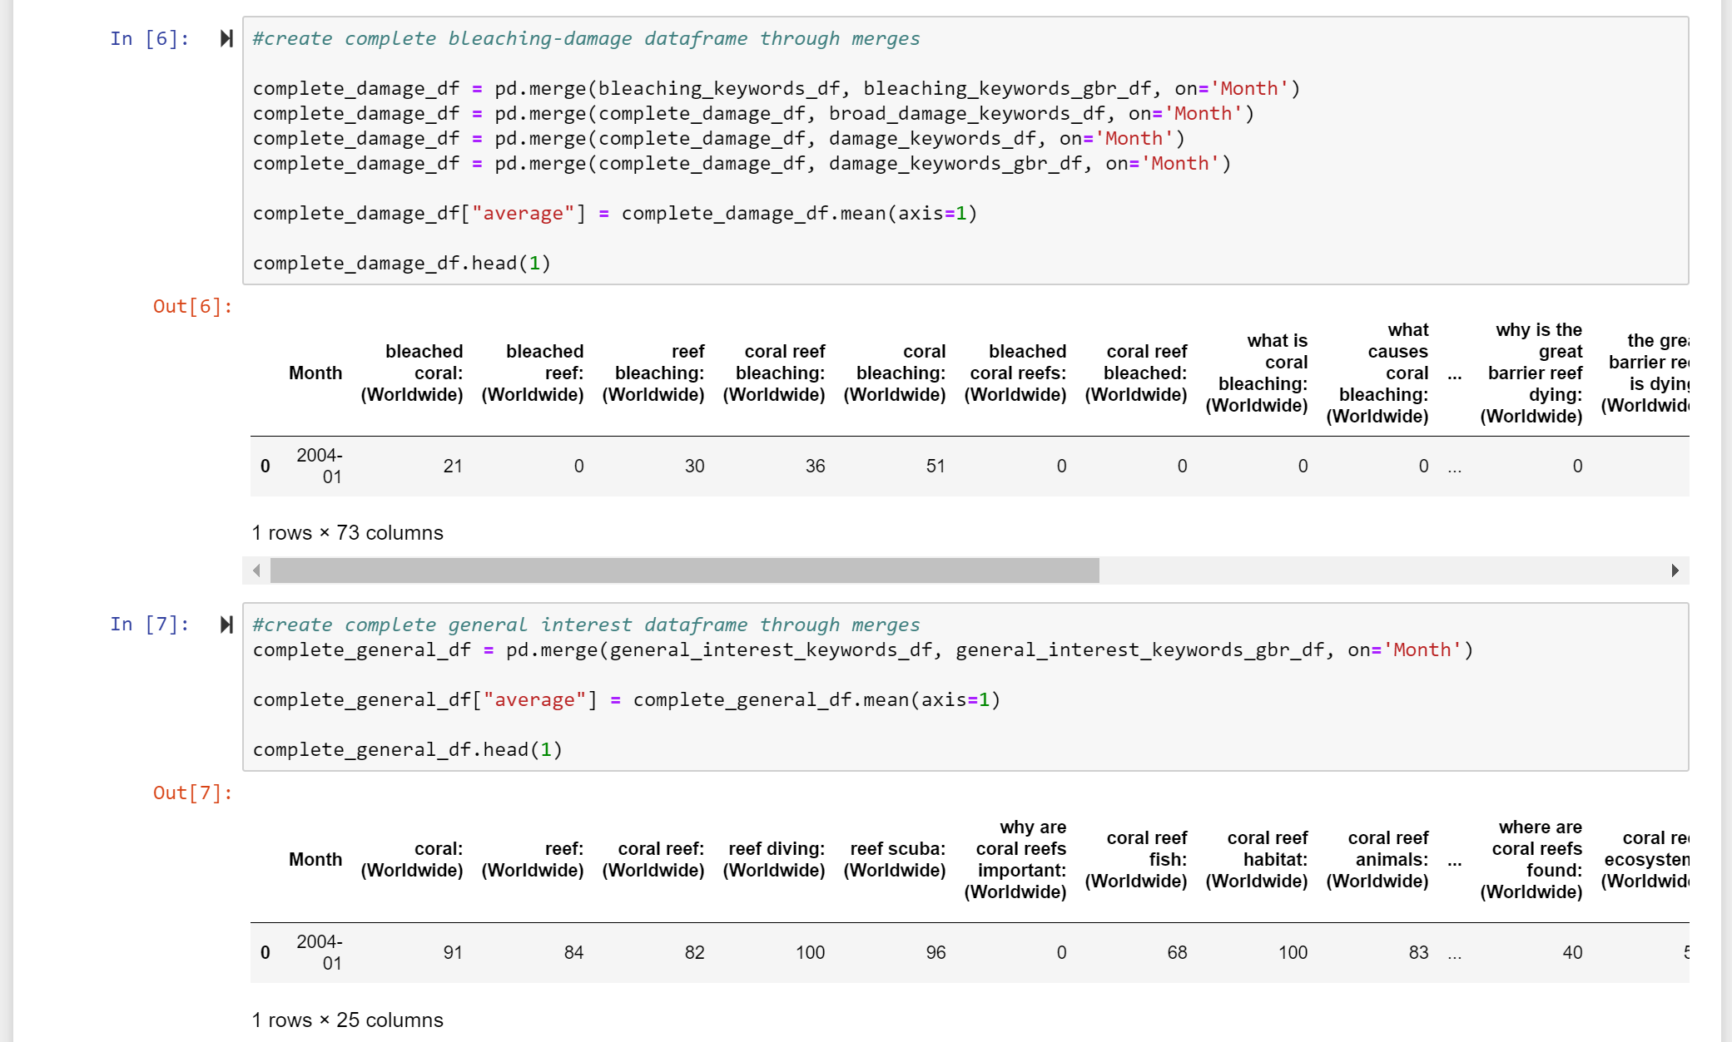
Data Cleanup & Exploration
Notes:
Discuss any problems that arose after exploring the data, and how you resolved them, and present and discuss interesting figures developed during exploration, ideally with the help of Jupyter Notebook

Slide 17
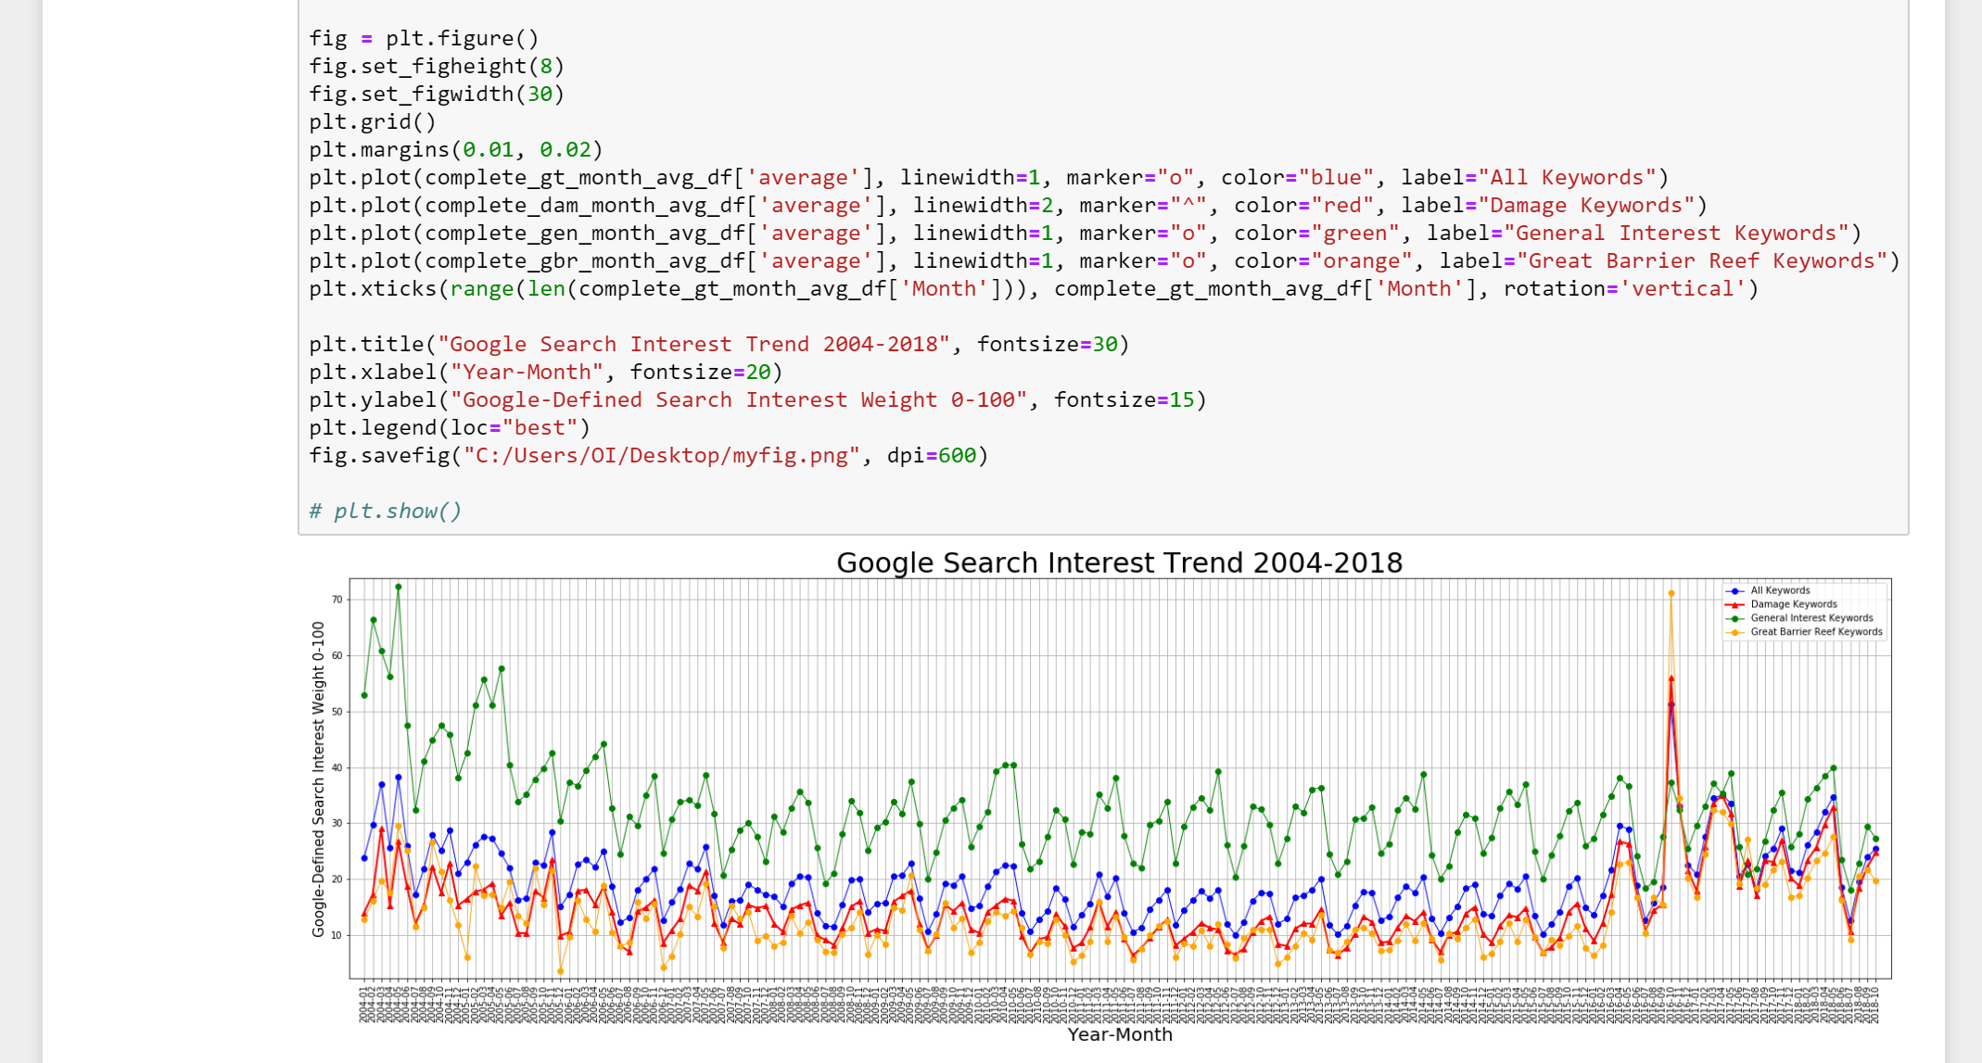
Data Cleanup & Exploration
Notes:
Discuss any problems that arose after exploring the data, and how you resolved them, and present and discuss interesting figures developed during exploration, ideally with the help of Jupyter Notebook

Slide 18
Data Analysis - Conclusion
Confirmed major bleaching event in 2015-2016
Confirmed increase in interest for reefs during bleaching events
Hypothesis Confirmed! –reject null

Slide 19
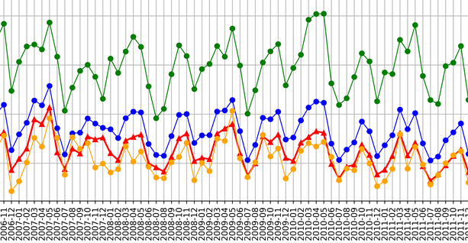
Findings Discussion
Mass bleaching events in 1998, 2002, 2005-2006 and most recently 2016 caused by unusually warm sea surface temperatures
Observed spike in google trends interest during the bleach in 2016
Note: tourism seasonality seems to influence query coral reef
Notes:
Did you find what you expected to find? If not, why not? What inferences or general conclusions can you draw from your analysis?

Slide 20
Post Mortem Discussion
Challenge to get data on reefs bleaching after 2012 due to lag in Scientific publishing
API data access only available for the last 30 days
We narrowed the scope of the project due limited access to social media time series data
If there was additional time the diversity of NYT articles by keyword should be expanded, and other sources of social media data should be exploited to more accurately resolve the impact
Another bleaching event is on the way, potentially the worst yet, setting up a twitter scrapping process might be interesting!

Slide 21
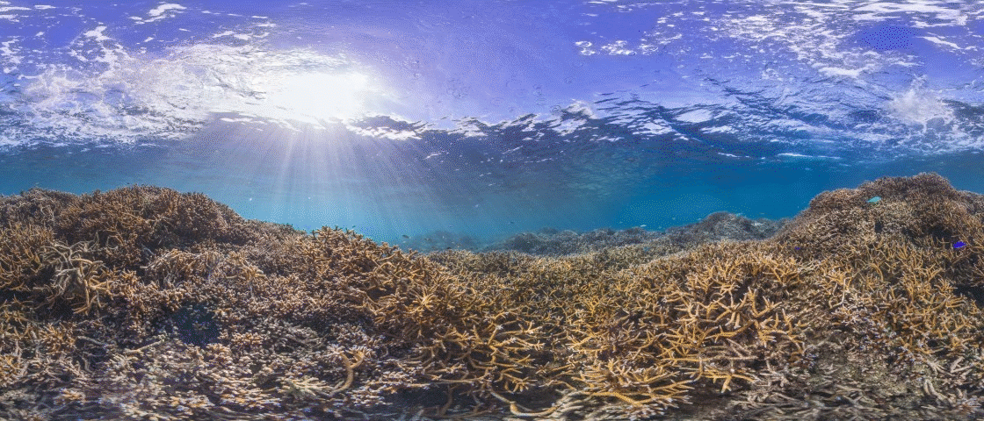
Q&A

